Slide 1
Automated Light Intensity Monitoring System
Presented by :-
Ankita Panpatil

Slide 2

OUTLINE
INTRODUCTION
SCOPE
PURPOSE
APPLICABILITY
LITERATURE SURVEY
SURVEY OF TECHNOLOGIES
REQUIREMENT ANALYSIS
OBJECTIVE
CONCLUSION
HARDWARE REQUIREMENTS
SOFTWARE REQUIREMENTS

Slide 3

INTRODUCTION
Internet of Things (IoT) is a small electronic device which senses and collects data from around the world and shares this data with backend applications.
It communicates with any object, environment, and infrastructure. Communication is a very important part of IoT.
The idea of IoT is quite useful for real-world applications and services. A few examples of the application of IoT technology are: Putting on the lights automatically on sensing the human activity, Similarly AC and all other devices need to run in an environment and be switched off based on certain event or trigger.

Slide 4
SCOPE
It’s the technology of today which is touching and transforming every aspect of our real life.
IoT has given a concept of Machine to-Machine (M2M) communication.
IoT is going to have huge impact on Automated Light Monitoring System and building automation system where every convenience will be taken care of by the interconnected devices on IoT.
In medical science field, IoT has given a privilege to devices and system to sense for coming disease.

Slide 5

PURPOSE
A Automated Light Monitoring System is an intelligent network-based lighting control solution that incorporates communication between various system inputs and outputs related to lighting control with the use of one or more central computing devices.
Lighting control systems are widely used on both indoor and outdoor lighting of commercial, industrial, and residential spaces.
Lighting control systems serve to provide the right amount of light where and when it is needed.

Slide 6

APPLICABILITY
Automated Light Monitoring System is a lighting technology designed for energy efficiency, convenience and security.
This may include high efficiency fixtures and automated controls that make adjustments based on conditions such as occupancy or daylight availability.
Lighting is the deliberate application of light to achieve some practical effect . It includes task lighting, accent lighting, and general lighting.

Slide 7


LITERATURE SURVEY
Internet of things is such a specified and dignified domain which leads us to the real world scenarios where each object can perform some task while communicating with some other objects.
The world with full of devices, sensors and other objects which will communicate and make human life far better and easier than ever.
This Project provides an overview of current research work on IoT in terms of Automated Light Intensity Monitoring System ,a technology used and applications.

Slide 8

SURVEY OF TECHNOLOGIES
Bolt Module
USB Cable
Bolt cloud
Bolt IoT Mobile App
LDR
Ohm Resistor
JavaScript

Slide 9

REQUIREMENT ANALYSIS
Hardware Requirement
Software Requirement
Bolt Module | 3.3V
1 x LDR | (2 legged devicewith a red wave pattern disk on top)
USB Cable | 5V
1 x 10k Ohm Resistor | (brown black orange color code)
Operating system | Windows 7 or above
TECHNOLOGY | JavaScript
BROWSERS | Google chrome
EDITOR | Cloud.boltiot.com

Slide 10
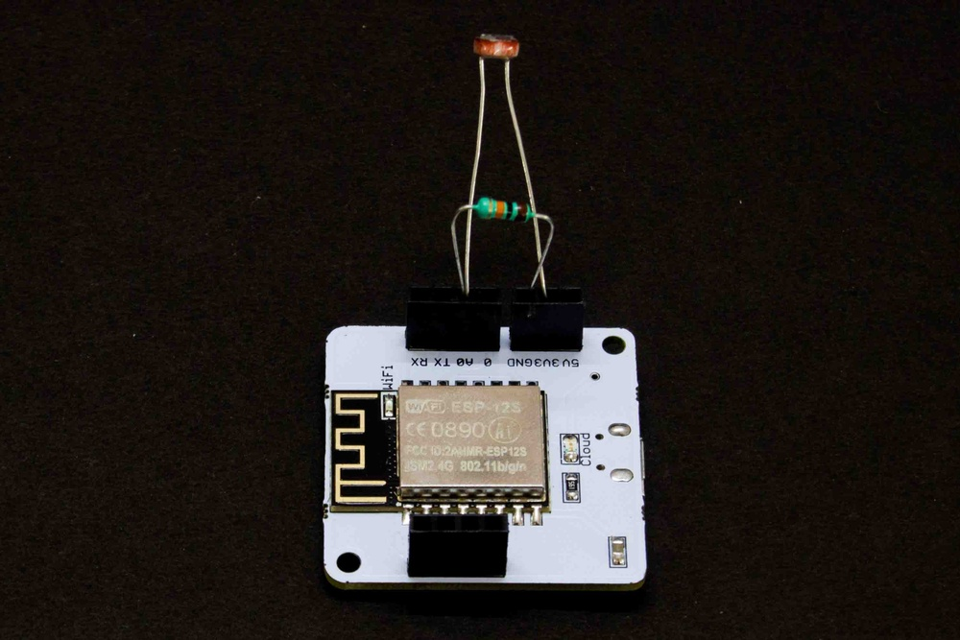

Slide 11
OBJECTIVE
Build an energy saving Automated Light Monitoring System with integrated sensors and controllers
Design a Automated Light Monitoring System with modular approach design, which makes the system scalability and expandability.
Design a Automated Light Monitoring System which compatibility and scalability with other commercial product and automation system, which might include more than lighting systems.

Slide 12
CONCLUSION
The Automated Light Monitoring System using Internet of Things has been experimentally proven to work satisfactorily by connecting simple appliances to it and the appliances were successfully controlled remotely through internet.
The designed system not only monitors the sensor data, like temperature, gas, light, motion sensors, but also actuates a process according to the requirement, for example switching on the light when it gets dark.
It also stores the sensor parameters in the cloud (Gmail) in a timely manner. This will help the user to analyse the condition of various parameters in the home anytime anywhere.

Slide 13
Thank you

